Slide 1
Full Stack Performance Tuning with ASP.NET Core
Dustin J Ewers | Consultant @ Centare
Twitter: @DustinJEwers
Website: www.dustinewers.com
Slides and Demos: https://github.com/DustinEwers/asp-net-performance-core

Slide 2

Speak Up!
(if you want to…)
Notes:
I want this to be fun and valuable.
… don’t need to hear myself talk the whole time.

Slide 3


Slide 4
Background
Notes:
Perf Improvement has been a part of every project I’ve been on
Lots of painful lessons
If we were more proactive about it, we’d have an easier time

Slide 5

Roadmap
Why?
What?
Design Considerations
Client Side Concerns
APIs and MVC Code
Data Access
Notes:
Photo by Andrew Neel on Unsplash
- we’re not going to talk about servers or hardcore database tuning

Slide 6

Why Bother?
Notes:
Photo:
https://unsplash.com/@jwimmerli?utm_medium=referral&utm_campaign=photographer-credit&utm_content=creditBadge

Slide 7
Notes:
Do we need to be fast for “lazy entitled millennials” ?
No! There are lots of reasons for quick applications.
Why should you make performance a priority?

Slide 8
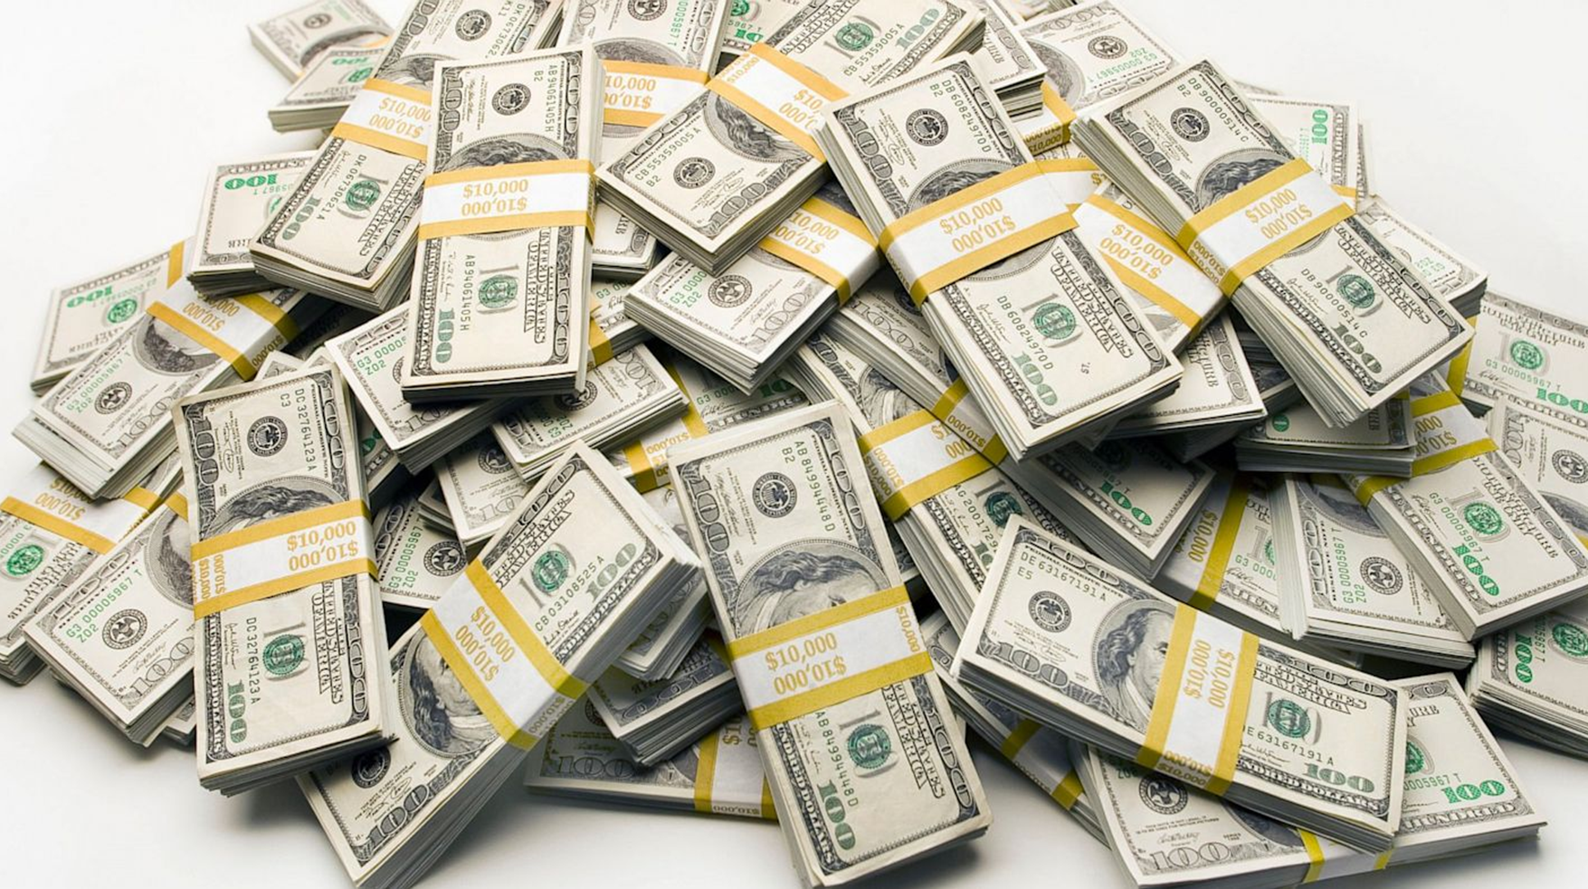
Notes:
If you like money, performance is for you

Slide 9
Small Performance Improvements = Big Bucks
Walmart – every 1 second of load time = +2% conversion rate
Walmart – every 100 ms = +1% revenue
Staples.com – 1 second = +10% conversion rate
Mozilla – 2.2 seconds = +15.4% downloads
Notes:
Illustrate that if a site is slow, you’re going to ditch that nonsense for a competitor

Slide 10
Two hundred and fifty milliseconds, either slower or faster, is close to the magic number for competitive advantage on the Web.
—HARRY SHUM,
EXECUTIVE VP OF TECHNOLOGY AND RESEARCH, MICROSOFT

Slide 11

People hate slow sites
Survey:
71% of people regularly feel inconvenienced by slow web sites
> 30% report increased performance related stress or anger

Slide 12

Slow sites are harder to use
Study:
5mb connection slowed to 2mb
Caused a 50% increase
in required concentration
Notes:
Time is Money – page 20
Concentration Measured by EEG
In 2011, CA Technologies commissioned Foviance, a customer experience consultancy, to conduct a series of lab experiments at Glasgow Caledonian Uni- versity.11 The participants wore an EEG (electroencephalography) cap to monitor their brainwave activity while they performed routine online transactions. Partici- pants completed tasks using either a 5 MB web connection or a connection that had been arti cially slowed down to 2 MB.
Brainwave analysis from the experiment revealed that participants had to concentrate up to 50% more when using websites via the slower connec- tion. When asked what they liked most and least about the websites they used during the study, participants frequently cited speed as a top concern:
Slow sites break flow and cause the user to be stressed.
Think about how this impacts testing and development, as well customer adoption

Slide 13

Do you want this to be your app?

Slide 14
Performance is ____
Notes:
All about the perception
Doesn’t matter what the “recorded” speed is. It’s all about what the user perceives.
----------
Photo:
https://unsplash.com/@jwimmerli?utm_medium=referral&utm_campaign=photographer-credit&utm_content=creditBadge

Slide 15

What’s Fast?
0.1 second = Instantaneous
1 second = seamless
1-10 seconds = keeps attention, (Danger Zone!)
> 10 seconds = loss of attention, (Hell no!)
Notes:
Time is Money, page 16
Any break in flow is bad news.
These are based on a study from the 90’s

Slide 16
What do people expect?
49% expect load times of 2 seconds or less,
18% expect pages to load instantly
Notes:
Time is Money, page 12

Slide 17
How to Measure?
Individual Performance
Aggregate Performance
Notes:
Individual performance – Miniprofiler, Stackify Prefix, Google Chrome Tools
-- Shell out to Miniprofiler | About page, customers page
Aggregate performance – Application Insights, other APM tools

Slide 18
Use Realistic Data
Notes:
Make sure to use realistic test data
If you need help, check out Bogus.Net

Slide 19
Design for Speed
Notes:
Photo:
https://unsplash.com/@jwimmerli?utm_medium=referral&utm_campaign=photographer-credit&utm_content=creditBadge

Slide 20
Async Slow Processes
Notes:
If you have anything that takes more than a second, async it. Shoot off the request and ping the user when it comes back. You see this all the time in the wild with order processing.
Service buses and messaging queues work wonders here
The goal is to get control back to the user.

Slide 21
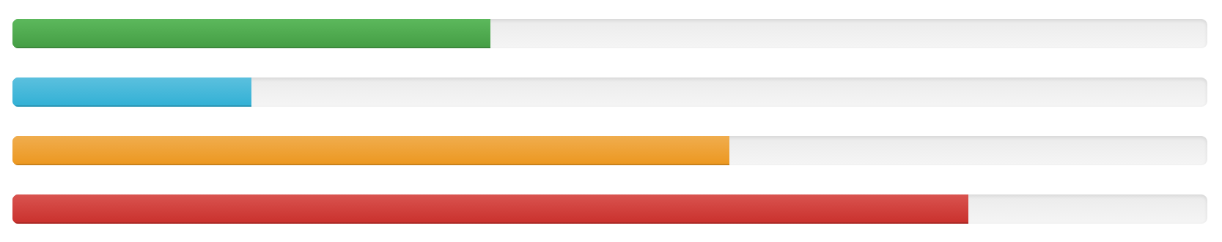
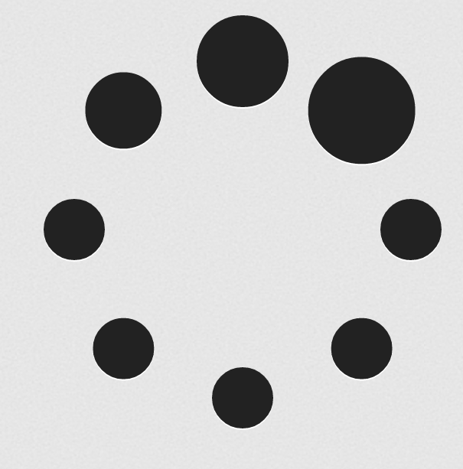
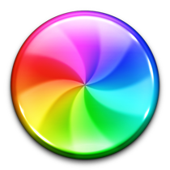
Progress Controls
Notes:
Use spinners and progress bars for long running operations
The key is immediate response to the user
Don’t block the user flow

Slide 22
Layers have a cost

Slide 23
Client Side Concerns
Notes:
Photo:
https://unsplash.com/@jwimmerli?utm_medium=referral&utm_campaign=photographer-credit&utm_content=creditBadge

Slide 24
Bundling and Minification (JS and CSS)
ASP.NET Bundle Files
Webpack
CLI Tools
Notes:
Reduce the number of assets your app pipes down
https://visualstudiogallery.msdn.microsoft.com/9ec27da7-e24b-4d56-8064-fd7e88ac1c40
Why?
Reduce file size
Reduce the number of requests
Easier to Cache
How?
If SPA Framework, use webpack or the CLI
If a basic MVC app, use the built in bundle config (comes with the template)

Slide 25
Dealing with Images
What?
Reduce file size
Reduce the number of requests
Reduce the number of images
How?
Shrinking your images
Image sprites
Icon Font (Glyphicons/Font Awesome)
Notes:
Reduce the number of assets your app pipes down
https://visualstudiogallery.msdn.microsoft.com/9ec27da7-e24b-4d56-8064-fd7e88ac1c40
Image shrinking:
https://tinyjpg.com/
Turn Down the Quality on your JPEGS:
60-70 will probably look OK
Sprite Generator:
http://css.spritegen.com/
Icon font generator:
https://icomoon.io/app/#/select

Slide 26
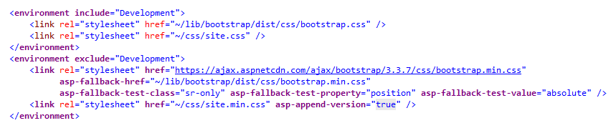
Content Delivery Networks (CDNs)
Notes:
Use a CDN to host your static assets.
Azure is really easy to setup. You can front a blob store with a CDN in about ten minutes.
Make sure you have a fallback.

Slide 27
APIs and MVC Code
Notes:
Photo:
https://unsplash.com/@jwimmerli?utm_medium=referral&utm_campaign=photographer-credit&utm_content=creditBadge

Slide 28
.NET Core vs. .NET
Notes:
I did a similar talk a few years ago using regular .NET, saying that core was faster
Not only is the .NET framework faster,
ASP.NET MVC Core incorporates many things you’d have to do manually into it’s pipeline.
Response compression is an example

Slide 29

Perhaps we should turn down the logging level…
Notes:
Excessive production logging is a “career limiting move”

Slide 30
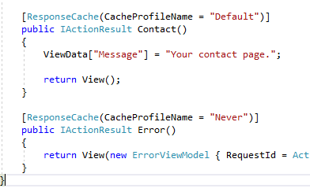
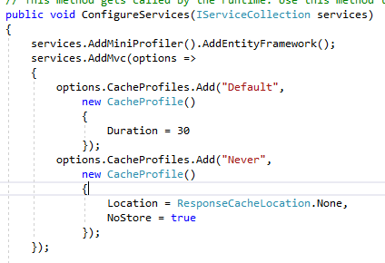
Response Caching
HomeController.cs
Startup.cs
Notes:
HTTP Response Caching can be done per method or you can add middleware that does it on all requests
Sets up the Cache-Control header
This one can get tricky. I usually spent more time removing this from items than adding it, but it can reduce load.
Don’t cache authentication

Slide 31
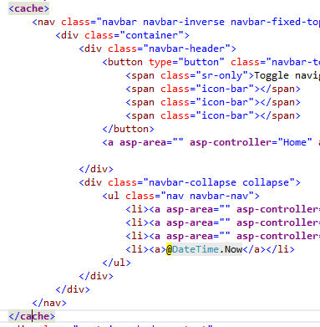
Caching Tag Helpers
Notes:
You can cache unchanging parts of the screen using the cache tag helper
*honestly, never used this, but it exists
Good for unchanging content like navs
----
Uses memory caching behind the scenes, but you can also use a distributed cache

Slide 32
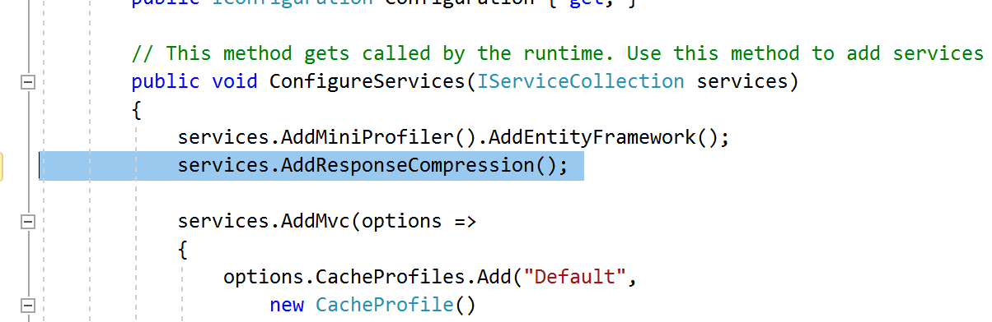
Response Compression
Notes:
You want to make sure all of your requests are gzipped. This will save you a ton of bandwidth.
21kb vs 7.3kb for a JSON request with 100 customers
Most of the time this is handled by IIS, but if you aren’t using it there
you can enable the response compression middleware
You used to have to do this manually… now it’s built in.
Responses not natively compressed typically include: CSS, JavaScript, HTML, XML, and JSON.
Defaults in the middleware:
text/plain
text/css
application/javascript
text/html
application/xml
text/xml
application/json
text/json

Slide 33
Send Less Over the Wire
Notes:
Don’t send unnecessary junk up to the client.
It weighs down your requests and can also result in weird serialization issues
Shopping cart serialization example

Slide 34
Data Access
Notes:
Photo:
https://unsplash.com/@jwimmerli?utm_medium=referral&utm_campaign=photographer-credit&utm_content=creditBadge

Slide 35
Consider a MicroORM
Notes:
Entity Framework is the default, but Dapper is really nice.

Slide 36
Data Caching
Notes:
Put your data caching on a single layer.
Caching adds complexity, so be mindful in what you cache and how long it’s cached for
.NET Core supports several mechanisms
Memory caching, not great for large farms
Distributed caching, I recommend REDIS over other mechanisms
Abstract your cache so you can swap it out as you grow

Slide 37
Include() Is Not Always Your Friend
Notes:
New EF is better, but a handful
In EF, you don’t execute the query until you enumerate the array.
This usually means “toList()”-ing it.
Sometimes, it’s faster to do some of that processing in .NET.
of includes can produce some gnarly queries

Slide 38
Don’t Grab Unnecessary Data
Notes:
Don’t summon a crap-ton of unneeded data with your requests.
Example where they pull huge transactional entities out of the database
This is why you miniprofiler
Example: Tons and tons of data being called by someone. To power a half dozen fields.
Exceptions – if you’re using a caching framework

Slide 39

Takeaways
Be proactive
Measure everything
Be conscious
Notes:
Be proactive – make perf a first class citizen
Measure everything – learn how to measure your flows
Be conscious – of what you’re sending to the client
Photo:
https://unsplash.com/@jwimmerli?utm_medium=referral&utm_campaign=photographer-credit&utm_content=creditBadge

Slide 40

The Choice is Yours.

Slide 41
Full Stack Performance Tuning with ASP.NET Core
Dustin J Ewers | Consultant @ Centare
Twitter: @DustinJEwers
Website: www.dustinewers.com
https://github.com/DustinEwers/asp-net-performance-core

